Slide 1
SW PM – key goal
Important
Goal: Build and deliver the SW product that:
Satisfies specs (no more, no less)
Is done on budget
Is done on schedule
Delights the customers
Is maintainable, easy to sell, well supported, documented and marketed…
“ Good is better than the best”
Copyright D. Petkovic

Slide 2
SW Management
Important
Process (learned in this course)
Technology (you studied it)
BUT also
People (surprise, this might be the key!)
Most SW project failures related to poor SW teamwork, management, process, not to technical issues
  Charette, R. N: “Why Software Fails.” IEEE Spectrum, September 2005, pp. 42.
Copyright D. Petkovic

Slide 3
What is SW management
Important
Project management
  Organizing, planning and scheduling SW projects
People management People Management
  Hiring, motivating, organizing, rewarding, assigning tasks
Cost Management
  Planning and estimating costs, productivity, monitoring costs etc.
Quality Management
  Quality assurance, standards, planning, control, SW measurements and metrics
Process management and improvement
  Process measurement and assessment, analysis and modeling, SEI Capability Maturity Model (CMM)
Copyright D. Petkovic

Slide 4
Why is managing SW unique
Important
SW is hard to see and touch ➔ hard to track progress. SW managers rely on others to write reports (they can not see the progress like in building a house)
Similarly, no complete requirements can be developed before hand, iterations are needed and thus surprises and delays are possible (this seldom happens in building a house). Then, requirements change
SW developers are often very individualistic and require special people management ➔ People Management
No standard process and no standard components (like in plumbing for example)
SW technology changes very quickly, making it hard for developers and managers to predict and estimate schedules
SW is often developed globally, more will be in the future
Copyright D. Petkovic

Slide 5
Tasks of SW Manager
Important
Development of product vision and goals, and communicating them
Develop a Plan – schedules, budget, resource needs and what is delivered (for the team and for the management)
Execute, manage to successful delivery
  Proposal writing and presentations
  Funding and budget management
  Planning
  Scheduling
  Costing
  Providing adequate resources
  Dealing with all stakeholders inside and outside the company
  Monitoring and tracking
  Reviews
  Help resolving technical conflicts
  Resolving personality conflicts
  Develop vs. buy vs. vend out decisions
  Report writing and presentations
  Dealing with global development
Copyright D. Petkovic

Slide 6
Skills needed for SW management are many!
Important
Technical background (may not have to be super detailed and current)
Communication, persuasion and people management skills
Knowledge of customers and usability issues
Knowledge of the application domain
Organizational capabilities
Meeting management
Some basic business knowledge
Understanding of different cultures (whether the project is global or not)
High energy, thick skin, stability
Other support structures (family, partners, friends)
Copyright D. Petkovic

Slide 7
Multiple communication
Needed for SW management
Upper management
Subcontractors
Clients, customers
Important
SW Manager
Peers (marketing,
Sales, docs)
Peers: business dev,
HR, finance
SW tech leads
SW developers
Copyright D. Petkovic

Slide 8
Project planning
Important
Project planning is iterative, ongoing activity:
Start form best plan you can get
Iterate, change, adjust often (more often in times of crisis or delivery) based on ALL pertinent information
  Technical
  Internal (progress of the team etc.)
  External (changes in user requirements, competition, market)
Keep overall goals in mind (delivery, schedules, budget and users)
Drastic changes in plan need to be approved and communicated (I.e. schedules are there to me met)
Remember: requirements change, and it is hard to monitor progress, so be nimble and iterative and check/revise often ➔ adopt agile SE processes
Copyright D. Petkovic

Slide 9
Variables in planning - they are related
Cost (people, resources)
Important
3 TRADITIONAL
LEVERS TO PLAY
WITH
Quality
Time (schedule)
(E.g. if you want more features
It either requires more people
OR more time OR quality needs to
be reduced)
SCOPE (features)
Unique to SW
Copyright D. Petkovic

Slide 10
Vertical vs. matrix management
Important
Vertical: all resources are in one department.
  Pros: easier to organize
  Cons: duplication, not optimal use of resources (I.e. repeated UI development team for each product line)
Matrix: Resources marshaled on per project basis from different departments
  Pros: better use of resources, optimal talent used
  Cons: harder to manage and organize. Critical to have cooperation between project manager in charge of project and other managers contributing resources
Copyright D. Petkovic

Slide 11
Typical structure of a project plan
Important
Introduction and project description (like M1, M2)
Project organization: the way teams are organized, people and their roles
Risk analysis: describes possible risks (M2)
HW and SW resource requirements: machines, tools, storage (M2)
Work breakdown: activities/tasks, milestones, deliverables (M2, M3)
Schedule: estimated times for each task, start, end, dependencies (M3)
Monitoring and reporting mechanisms: what management reports will be produced, how often, how will it be monitored etc.
Copyright D. Petkovic

Slide 12
Checkpoints, Milestones and deliverables
Important
SW is hard to “touch and see”, it is intangible ➔ some verifiable and well defined milestones are needed for monitoring the progress
Checkpoint: a defined time you will check some specific smaller issue (used internally to resolve technical or other problems)
Milestone: end point of some logically distinct and defined activity: report, mockups, algorithmic solution, DB connected to UI etc.
Deliverable: milestone that is delivered to somebody outside of the project, can be verified and measured. Often has contractual importance.
Deliverable is also a milestone, but milestone may not be a deliverable
M1-4 are milestones, M5 is deliverable
Spread milestones/checkpoints in time, at least every 2-3 weeks)
Copyright D. Petkovic

Slide 13
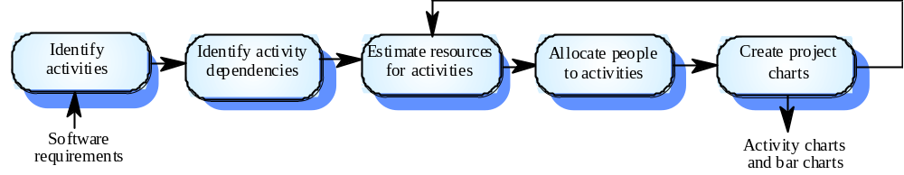
The project scheduling process
Important
Copyright: Ian Sommerville

Slide 14
Task duration and definition
Important
Initially, allocate at most weekly granularity for tasks, later use short duration (usually down to 2 days)
If task is more than 8 weeks, set a checkpoint/milestone in between
Initially have weekly check procedure
  Progress report to manager, rolled up
  Meeting
More often would add too more overhead
Exceptions in time of crises, resolving risks, close to delivery
Even daily meetings can be effective if done properly
Report on progress by all (go around the table):
  On track or not, issues, risks
Copyright D. Petkovic

Slide 15
Duration and resource estimation
Important
Usually provided by SW developers or tech leads
Various people have different ability to estimate: some always underestimate. Know this and readjust for each person
Use previous experience (good or bad)
Do not assume everything will be fine
Principal resource in SW development is human time
The more novel, the more risky ➔ readjust the schedule
Do not forget unit testing, integration testing and documentation
Rule of thumb: whatever people tell you, multiply with 1.3 or 1.5 safety factor
Copyright D. Petkovic

Slide 16
Mythical man-month syndrome
Important
Coined by Brooks (at times where mostly men were doing SW)
  Adding people late in the project is counterproductive: people training and integration effort is most often more than the original delay
Think how long it takes to get a new person to be productive – easily 2 months…
  Develop the job adv. and get management approvals
  Advertise
  Collect resumes and evaluate
  Interview
  Bring on board
  Train
Copyright D. Petkovic

Slide 17
Ways to present project schedules
Important
Bar charts
Activity networks
Gantt chart (e.g. implemented in Microsoft Project)
Can be done in simple document editors or special tools (Simple, no special tools is OK and desired)
Copyright D. Petkovic

Slide 18
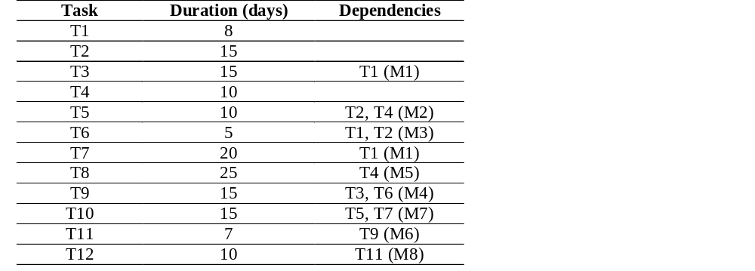
Task durations and dependencies
Important
Copyright: Ian Sommerville

Slide 19
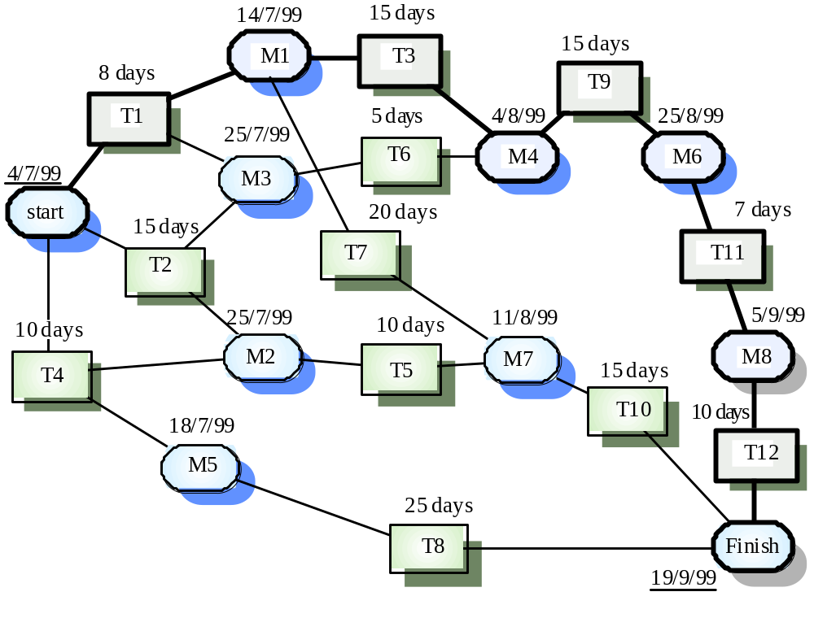
Activity network
Important
Critical
path
Copyright: Ian Sommerville

Slide 20
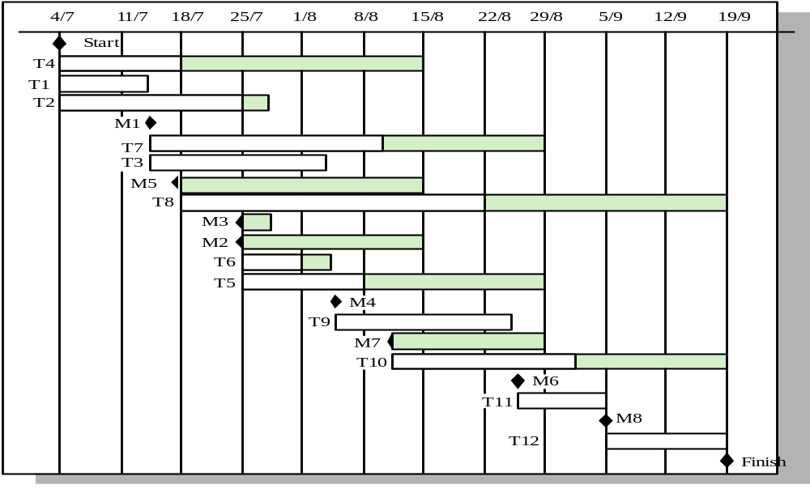
Activity timeline (Gantt chart)
Important
Copyright: Ian Sommerville
Copyright D. Petkovic

Slide 21
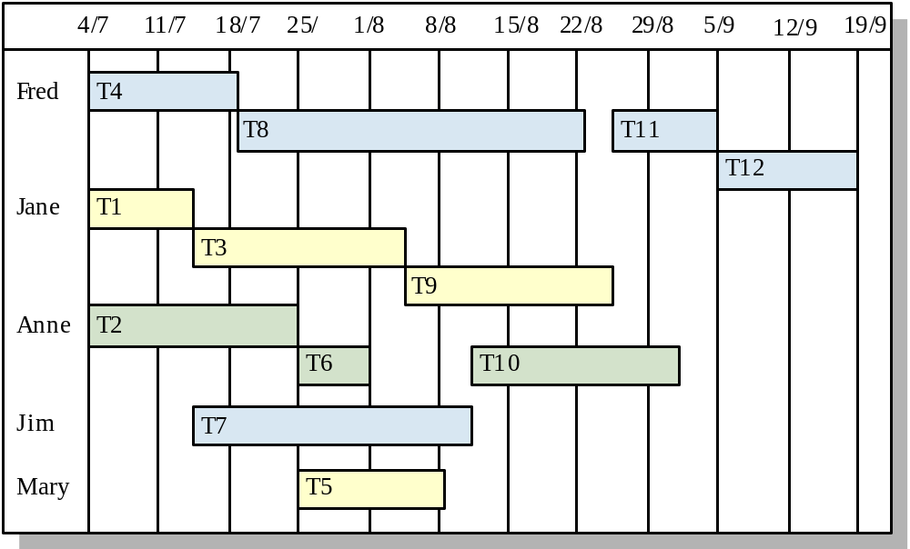
Staff allocation (Gantt chart)
Important
Copyright: Ian Sommerville

Slide 22
Dependencies
Important
Often, for one task to start, one or more tasks gave to be completed first ➔ dependencies
Milestones have multiple task dependencies ➔ all those tasks have to be completed before milestone can be reached
Critical path: the longest path in the activity charts ➔ it determines the duration of the projects
Delays in critical path task cause delay in the project
Delays in non-critical path tasks may be tolerated as log as they are less than critical path
Copyright D. Petkovic

Slide 23
One suggested simple format for project management task list (Prof. Petkovic)
Important
Function or req. name | Description | Duration | Milestone start/end dates (design, impl, test) | Dependencies | Persons in charge | Comments
Copyright D. Petkovic

Slide 24
1) Use project requirements and design documents (tasks, UI, use cases, architecture) + budget, resources and completion date to get basic info and project parameters and constraints (I.e. Final Project M1 and M2)
2) Define project tasks, milestones and deliverables (variables: cost, time, quality, scope)
3) Define dependencies
4) Estimate task duration
5) Estimate task resources (people, equipment, SW, HW)
6) Draw up project schedule (I.e. backproject from desired completion date.
IF big changes needed go back to Step 1)
7) Review periodically (more often toward the end of the project or when risks are identified)
8) Revise as necessary
9) IF problems arise initiate review
10) Loop back to Step 6 until project done
Only if critical problems arise
Important
Summary:
Steps in project
management
Copyright D. Petkovic

Slide 25
Teamwork
Important
What is it?
Teamwork vs. group work
http://en.wikipedia.org/wiki/Teamwork
Review this link
  http://www.ndt-ed.org/TeachingResources/ClassroomTips/Teamwork.htm
Copyright D. Petkovic

Slide 26
Teamwork
Important
Good teamwork creates:
  Shared team goals
  Whole team works on one problem – one major deliverable for the whole team (vs. groupwork where each member delivers his/her own)
  Effective team being able to execute on budget, on schedule and per sects
  Encouragement of innovation, producing useful and innovative ideas and making them happen
  People who feel productive, not burnt out
Teamwork is NOT:
  Design by committee
  Making key decisions by voting or averaging
  Suppression of individual talent
  Encouragement of mediocrity
  Place to hide poor performers
Copyright D. Petkovic

Slide 27
Group work vs. Teamwork
Important
Group work: Working together to deliver M0 is group work – you help each other but each of you ahs to do his/her same M0 deliverable
Teamwork: Working on final class project is teamwork – you all work together on pieces to complete ONE deliverable
Copyright D. Petkovic

Slide 28
Professionals in terms of the motivation (Bass, Dunteman 1963)
Important
Task oriented: motivated by the work they do. Often like to work alone
Self-oriented: primarily interested by personal success. Often like to work alone
Interaction-oriented: motivated by interacting with co-workers and users (important for UI). Usually better communicators, like to work in a team
What are you?
As a manager, know this for your people and assign them to roles consistent with their motivation
Copyright D. Petkovic

Slide 29
Teamwork – challenges
Important
From Lancioni (via Wikkipedia): Five dysfunctions of a team
  http://en.wikipedia.org/wiki/The_Five_Dysfunctions_of_a_Team
Absence of trust —unwilling to be vulnerable within the group
Fear of conflict —seeking artificial harmony over constructive passionate debate
Lack of commitment —feigning buy-in for group decisions creates ambiguity throughout the organization
Avoidance of accountability —ducking the responsibility to call peers on counterproductive behavior which sets low standards
Inattention to results —focusing on personal success, status and ego before team success
➔ Know it, address it, manage it (as a team member and a team lead)
Copyright D. Petkovic

Slide 30
Current research on team success
Important
Team success correlates with team cohesion and NOT with the sum of team members IQs or expertise
Copyright D. Petkovic

Slide 31
People “stuff” in SE
Important
People “stuff” is critical for success of SW projects
People are the key and biggest asset in SW companies ➔ proper management and motivation of the people is the key
Upper management, client management and users are people, and they have to be “managed” also
People management involves some policies and rules, but above all it is about proper communication, motivation, listening and respect
Balancing individualism v.s. team work
Copyright D. Petkovic

Slide 32
What is teamwork in SE (definition by Petkovic, Thompson, Todtenhoefer, Huang, Sosnick)
Important
Knowledge and proper application of SE processes
Knowledge of team organization and dynamics in SW development (theory, best practices)
Proper personal team behavior: ethics, courtesy, attendance, being reachable and responsive
Knowledge and proper application of SW development tools
Knowledge and application of team collaborative tools
Copyright D. Petkovic

Slide 33
SW teamwork involves many skills
Important
Work ethics, follow up of required processes (meetings, time cards, documentation formats)
Personal behavior
Verbal communication
Written communication (e-mail, specs, forums, code reviews)
Understanding usage of collaborative tools for: a) communication; b) SW development
Knowledge of team “theory” and best practices in SW eng.
Ethics, respect of diversity and cultures
Hard to teach, need practice and some “theory”
Copyright D. Petkovic

Slide 34
People in SW
Important
People are the major element in SW development
Productivity of SE varies dramatically compared to other professions
  Home window replacement: 1 person takes 1 to 1.5 h
  SE productivity: can vary over 10 X between people
People management is the key for success of SE projects
Copyright D. Petkovic

Slide 35
SW development as a teamwork
Important
SW teams can range from 2 to several hundred
Work together (same room) to different countries, language, time zone
Best group size up to 8 members, responsible for a product or well defined subsystem
Smaller groups are much better in terms of organization and communication ➔ critical factor
Most innovation comes from 1-3 people, then gets implemented by larger teams
Copyright D. Petkovic

Slide 36
SW development as a teamwork (2)
Important
Making groups work effectively is critical task of team leads and project managers
  Development and communication of shared project vision and goals
  Hiring
  Getting team organized and trained
  Motivating and sustaining motivation
  Tracking progress
  Providing adequate resources
  Resolving conflicts (technical, personal, resource, schedule, priorities, comm. between SW team and stakeholders…)
  Managing different phases differently (design, innovation, execution…)
Copyright D. Petkovic

Slide 37
SW teams
Important
Composition: balance of skills, experience and personalities
Cohesiveness: is this a team or collection of individuals
Communication: do group members communicate effectively with each other
Organization: is the organization such that everybody is effective and the whole team is productive? Can the best idea win? Can the team execute and deliver?
Copyright D. Petkovic

Slide 38
SW team organization
Important
Informal, with implicit technical leader. No formal authority exists. Decisions made democratically. Works best for small groups
Extreme programming concept is the variant of the above where programmers work in a team of two, and all decisions are made in a group setting. Requires highly competent and motivated people
Chief programmer team: very skilled person responsible for all key decisions and implementation, the rest are supporting him/her. May work, but may cause resentment, and requires really good chief programmer
Project manager, team lead, team members: most common today
Copyright D. Petkovic

Slide 39
SW team organization (2)
Important
Project manager, team lead, team members
Eng. management (often less technical, mostly business)
  Project manager
    Tech lead or chief architect or Lead programmer
      SW team members (coming from same or different organizations)
Optional: external vendors, subcontractors
Can have personnel manager in case of matrix management (manages people salary, vacations, promotions etc.)
In case of global teams: some roles can be repeated locally (e.g. team lead)
Copyright D. Petkovic

Slide 40
Lead programmer or Team lead or Project Manager
Important
Usually: lead programmer denotes primarily technical role, while team lead also includes some managerial tasks, and project manager is focused on resource management and scheduling
Lead programmer Team lead Project Manager
Definition for lead programmer from Wikipedia
  http://en.wikipedia.org/wiki/Lead_programmer
More technical
Less technical
Copyright D. Petkovic

Slide 41
Team lead roles
Example job advertisements
  http://www.mustang-technologies.com/LinkClick.aspx?fileticket=k4m92HX%2FfhQ%3D&tabid=36
  http://www.geomaticscanada.com/jobs_view.cfm?jobid=521&cid=652
/
Dragutin’s rules:
  Develop common vision and goals (with management, stakeholders…) AND communicate it to all
  Hire the best and continuously motivate people
  Make sure the best ideas win, be open to “out of the box” thinking
  Know when to encourage discussion, and when to force the decision
  Balance managerial and team lead role with individual work, focus on team lead role
  Communicate well in 360 degrees (people, peers, upper management)
  Use humor…life is stressful enough…
Important
Copyright D. Petkovic

Slide 42
Globalization, outsourcing and teamwork
Motivation
Get talent you need in a very short time
Access to local market with specific requirements
Reduce cost (do not forget cost of maintenance, problem handling) – becoming less of as factor lately
Simplify adherence to specific county legal, import and business requirements
Teamwork related positives:
Meet wonderful new people from different cultures
Make new personal, professional and business connections
Travel to distant lands
Important
Copyright D. Petkovic

Slide 43
Globalization, outsourcing and teamwork
Important
Significant Challenges:
Complicated management (people, business, project, multiple management chains)
Teams may have different objectives
Loss of coordination
Harder to resolve conflicts
Cultural differences, diverse team members
Impediments due to time zone differences and lack of personal contact
Copyright D. Petkovic

Slide 44
Globalization, outsourcing and teamwork
Important
If you are part of global team:
  Be very aware of the challenges specific to globalization
  Work on establishing personal connection early – use phone, Skype, video, images for introduction, travel if possible
  Create common goals
  Be sensitive to cultural and diversity issues
  Create process for conflict resolution
Copyright D. Petkovic

Slide 45
Managing conflict - some rules
Always present, the key is how you manage it:
First try to resolve within the group among involved parties
If that does not work, involve team lead or trusted outside person
If that does not work involve management
For global environment:
First try to resolve issue within local groups
If that does not work involve team leads from all groups
If that does not work, escalate to management from all groups
Ultimately, one single person resolves the conflict
Important
Copyright D. Petkovic

Slide 46
Behavior and attitude are critical in conflict management
Separate technical from personal issues
Be courteous
Focus on problems, not personalities
Fight for your ideas, but must ultimately think of what is best for the project, the team, the company
Do not send problematic e-mail, use meetings or phone
For managers and team leads: encourage “out of box thinking” and balance it with the need to come to common plan and execute on time and budget and per specs
Important
Copyright D. Petkovic

Slide 47
Teamwork issues: personal behavior and teamwork ethics are critical
Important
Phone manners
  http://ezinearticles.com/?20--Business-Telephone-Etiquette-Tips&id=246471
E-mail manners
  http://www.emailreplies.com/
  http://careerplanning.about.com/od/communication/a/email_etiquette.htm
Meeting manners
  http://www.chatgrispress.com/Articles/Business/11_Commandments_for_Bus_Meet_Etiquette.pdf
Attend meetings on time or let people know if you can not
Respect different personalities and cultures
Dealing with conflict
Assertiveness vs. aggressiveness
Understand company culture and “Implicit behaviors and rules”
Global issues: different countries have different culture and rules
Copyright D. Petkovic

Slide 48
Important
Rubrics for grading the final project
Measured Team Outcomes for SE process | Measured Team Outcomes for SE product
Fraction of the team participating at the meetings with the instructor Quality and timing of follow-up on outstanding issues Ability to deal with feedback constructively Producing the non-SW and SW deliverables on time Quality and completeness of non-SW deliverables (requirements, use cases, UI mockups, design documents, test plans etc.) Number of teamwork issues that instructor had to deal with (whether resolved or not) Ability to apply best SE process and teamwork practices Ability to effectively use the SE tools (e.g. collaborative tools, version control, issue trackers) | Correctness and reliability of operation Functionality of the product vs. desired requirements and use cases Ease of use, user interface Architecture of the developed system Database design Performance Code quality (coding principles, style, documentation) Presentation style and effectiveness of final product demonstration (content, delivery, adherence to time, dealing with Q/A)
25 %
25 %

Slide 49
1. PUBLIC - Software engineers shall act consistently with the public interest.
2. CLIENT AND EMPLOYER - Software engineers shall act in a manner that is in the best interests of their client and employer consistent with the public interest.
3. PRODUCT - Software engineers shall ensure that their products and related modifications meet the highest professional standards possible.
4. JUDGMENT - Software engineers shall maintain integrity and independence in their professional judgment.
5. MANAGEMENT - Software engineering managers and leaders shall subscribe to and promote an ethical approach to the management of software development and maintenance.
6. PROFESSION - Software engineers shall advance the integrity and reputation of the profession consistent with the public interest.
7. COLLEAGUES - Software engineers shall be fair to and supportive of their colleagues.
8. SELF - Software engineers shall participate in lifelong learning regarding the practice of their profession and shall promote an ethical approach to the practice of the profession.
IEEE/ACM code of ethics V 5.2 - summary
Important
Copyright D. Petkovic

Slide 50
Some other things you need to know – Intellectual Property (IP)
Important
Copyright
Trademarks
Patents
Trade secrets
SW licensing
Note: critically important in USA – has legal and criminal consequences
Copyright D. Petkovic

Slide 51
Copyright (SW)
Important
Copyright protects the expression of an idea, not an idea itself – defines the excusive owner
Used for images, text, music, SW code
Gives rights to the owner and protects from unauthorized copying – use requires permission of the owner
(Does not define the distribution – that is done by licensing)
See http://en.wikipedia.org/wiki/Copyright
SFSU students own copyright to the SW and any material they produce as part of their student work at SFSU
Copyright D. Petkovic

Slide 52
Trademarks
Important
Used to protect distinct logo, sign, word, phrase specific to business or service
Can be registered or unregistered
See http://en.wikipedia.org/wiki/Trademarks
Copyright D. Petkovic

Slide 53
Patents
Important
Protect an idea, not particular implementation or embodiments
Covers for e.g. algorithm, methods, processes, medical drugs
Granted for period of time to inventors/organizations
Must be applied for
Check http://en.wikipedia.org/wiki/Patent
Familiarize yourself with how patent looks http://www.google.com/patents/about?id=Q7AkAAAAEBAJ&dq=dragutin+petkovic+qbic
Copyright D. Petkovic

Slide 54
Trade secrets
Important
Method, formula, process kept secret by the company (and not patented) to offer it competitive advantage (note: patents expire after some time).
Coca Cola
Check http://en.wikipedia.org/wiki/Trade_secrets
Copyright D. Petkovic

Slide 55
SW licensing
Important
SW license is legal way of covering its distribution (different from copyright which covers the ownership/authorship)
Commercial e.g. when purchasing SW (EULA’s – end user licensing agreement)
Open Source allow free distribution (BUT check for details – is the SW which uses Open Source also required to be free?)
Check http://en.wikipedia.org/wiki/Software_license
Copyright D. Petkovic

Slide 56
IT usage and SW licensing at SFSU
Important
Familiarize yourself:
  http://www.cs.sfsu.edu/acceptable_use_policy.html
  http://www.cs.sfsu.edu/grad/software-policies.html
Copyright D. Petkovic

